Slide 1

By : Omar M.Hussein, Sara Ferrari & Zhihong Zhan

Slide 2
The “How Might We?”
Improve the interactivity and means of communication of the Canvas system.
For education, connections between students and professors are crucial. Moreover, student interaction is imperative to enhance communication and sharing. Having everything self-contained within the Canvas application makes the tool more attractive and will increase market share.
Facilitate communication between all parties involved.
Improve a Notification feature and add integrated instant messaging to facilitate sharing and communication.
Challenge
Subject
Small HMW
Solution

Slide 3


Value Proposition
Notes:
https://www.youtube.com/watch?v=t8uoRCfN2co

Slide 4
Value Proposition
Simplicity
Easily Accessible
Privacy & Security
Features
Instant messaging is integrated into Canvas.
Users do not need to install an extra app.
The UI is straightforward.
The app works on both iOS and Android.
Canvas-Me provides services without needing a phone number. All messages are secured using state of the art end-to-end encryption.
Ability to customize groups
Easy and fast communication with group members
Highly integratable and consolidated.

Slide 5
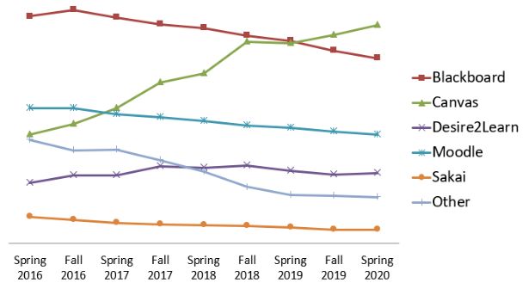
Understand
North America market share: 35%
Increasingly popular
Our survey showed:
A Need for more communication
A Desire for more flexibility in file sharing
Notes:
Picture: https://edutechnica.com/tag/market-share/
Data: https://philonedtech.com/state-of-higher-ed-lms-market-for-us-and-canada-2019-mid-year-edition/

Slide 6


Design thinking
Call me by my name
You've Got Mail
Create for each account a starred contact list with the classmate, professor, TA connection and connect it to YU mail.
Using the report on email is not the most efficient way to interact on time. We need to create notifications like any other app when something that you like changes or is added.
If you can write it you can read it
Time to {Group}
Professors can put evaluations in an Excel format and submit them.
Students can also download information locally in Excel format for each class and grade.
Create groups freely within your class and peers in school. Also class groups are created automatically
Notes:
© Copyright PresentationGO.com – The free PowerPoint and Google Slides template library

Slide 7






Decide, Select
We decided to unify two ideas into one
We made the survey and after the results we voted again
We voted independently the different ideas coming from the design thinking
During the implementation we understood that having an external application wasn’t the right answer
We decided to integrate the instant messaging into Canvas
During the test phase we also added into the principal menu the shortcut for the messaging

Slide 8
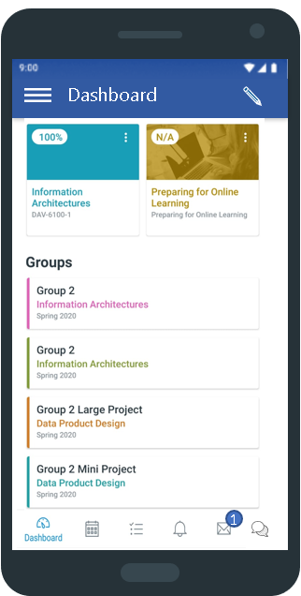
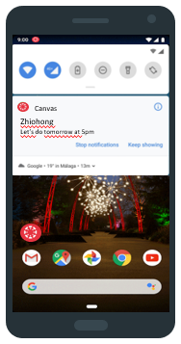
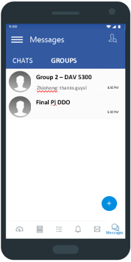
Prototype
Integrated in Canvas
Notifications & AI Evites
Automated and Customize Groups
Notes:
https://www.youtube.com/watch?v=6gH5vHaXSDc

Slide 9
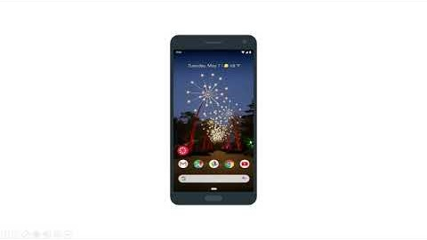
Prototype
Notes:
https://www.youtube.com/watch?v=6gH5vHaXSDc

Slide 10


Validate, Test
Ankush
Student at YU
Ghorani
Student at University of Nottingham (Moodle LMS)
«The best thing is that you can create a standard normal text»
«The AI feature was really helpful and cool»
«I feel like this is basically compiling everything i need as a student and gives all in one experience and it is practical»

Slide 11
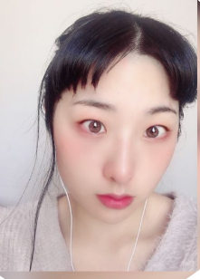

Validate, Test
Yalin Yen
Student at YU
Julian
Student at YU
«This will save us a lot of time and i like it a lot but privacy is very important and i am not sure if it safe»
«You can use it without much explanation, if you add that feature to canvas tomorrow i will be able to use that one»
Notes:
https://pterylographic-exec.000webhostapp.com/

Slide 12
Technical
Our data product is based on data that Canvas already possess, emails and users . The only aspect that we have to consider is the safety of the chat which should be straightforward using end-to-end encryption.
For the people who want to build the real application of our demo, swift will be used on programming it on the iOS and Java and Android studio will be mainly used on Android development.
The only thing that Canvas has to add is a team of engineers to make it real.

Slide 13

Q&A
Notes:
For more information check our website:
https://pterylographic-exec.000webhostapp.com/

